Slide 1

Sample Store Analysis

Slide 2
Ashraf Mohamed Reda
Sample SuperStore Analysis Tableau Project
12 / 8 / 2024

Slide 3
Agenda
PROJECT OVERVIEW
Dashboard Photo
Project View Chart
KEY INSIGHTS
RECOMMENDATIONS
Refrences

Slide 4
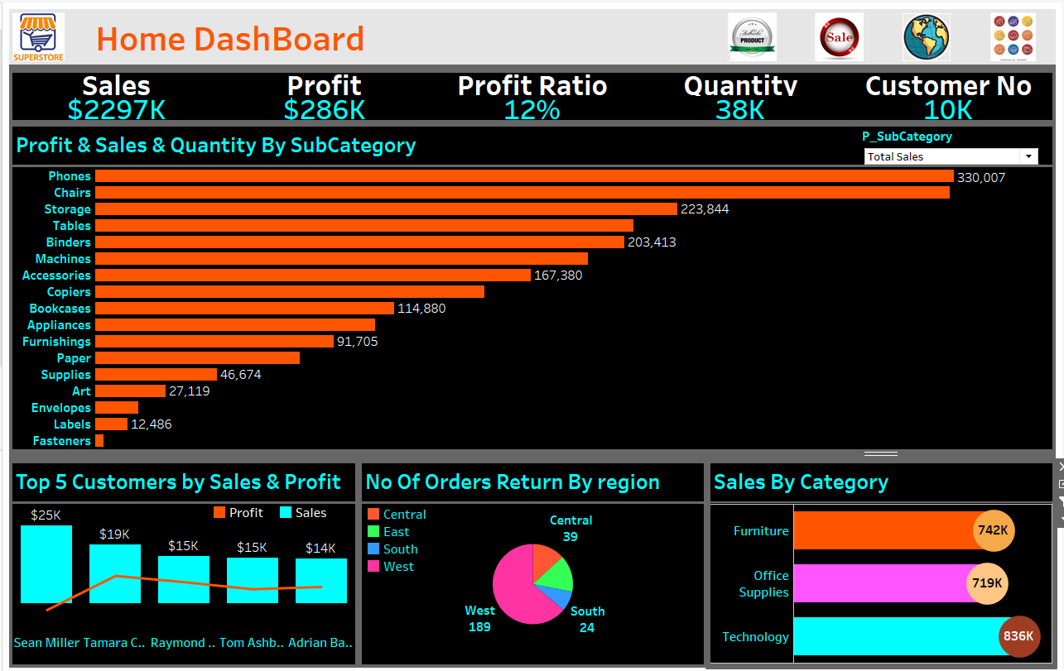
Home DashBoard

Slide 5
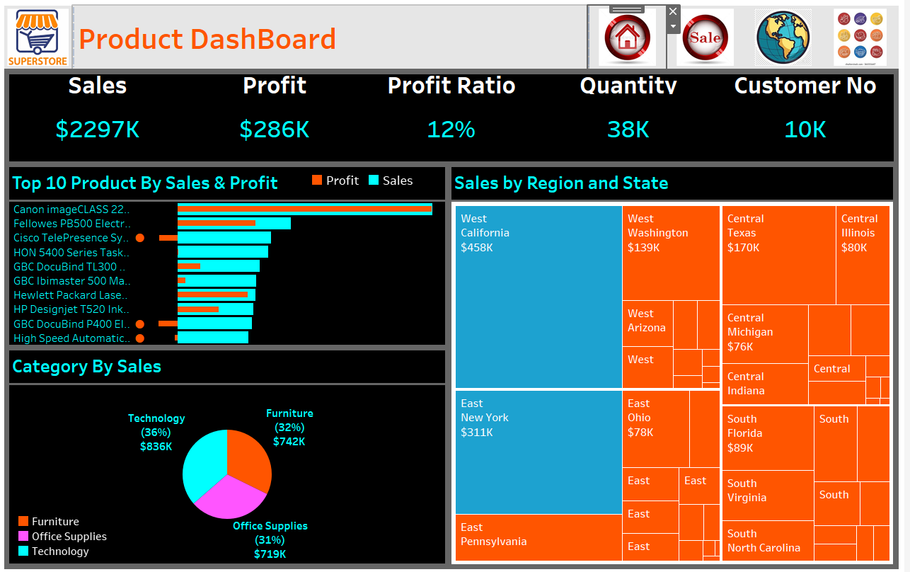
Product DashBoard

Slide 6
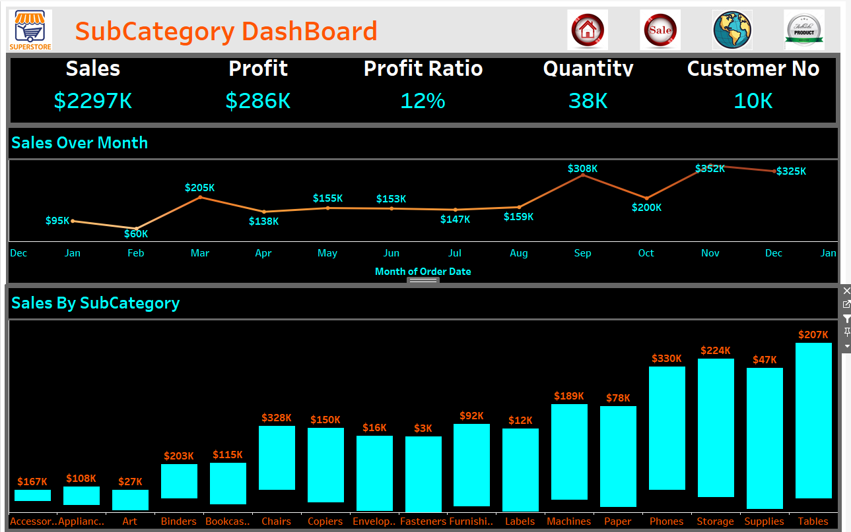
SubCategory DashBoard

Slide 7
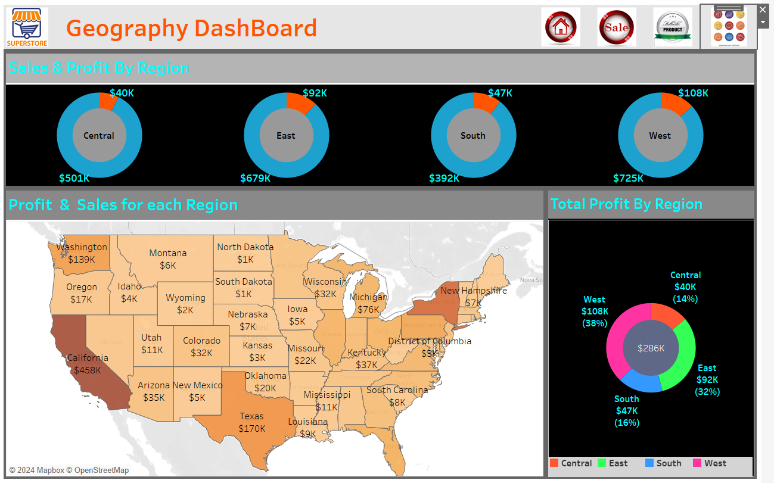
Geography DashBoard

Slide 8
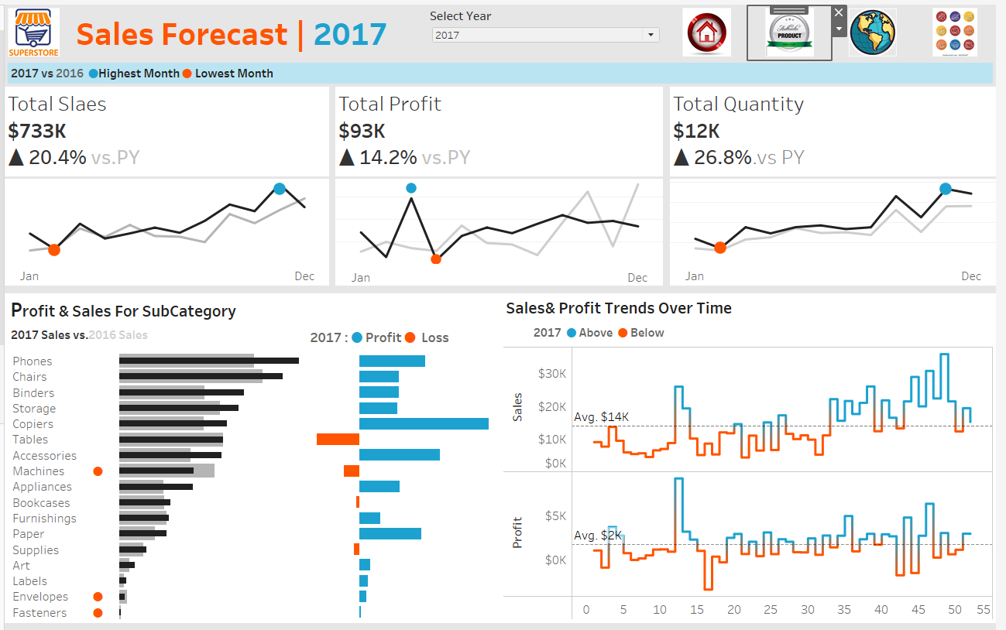
Sales DashBoard

Slide 9
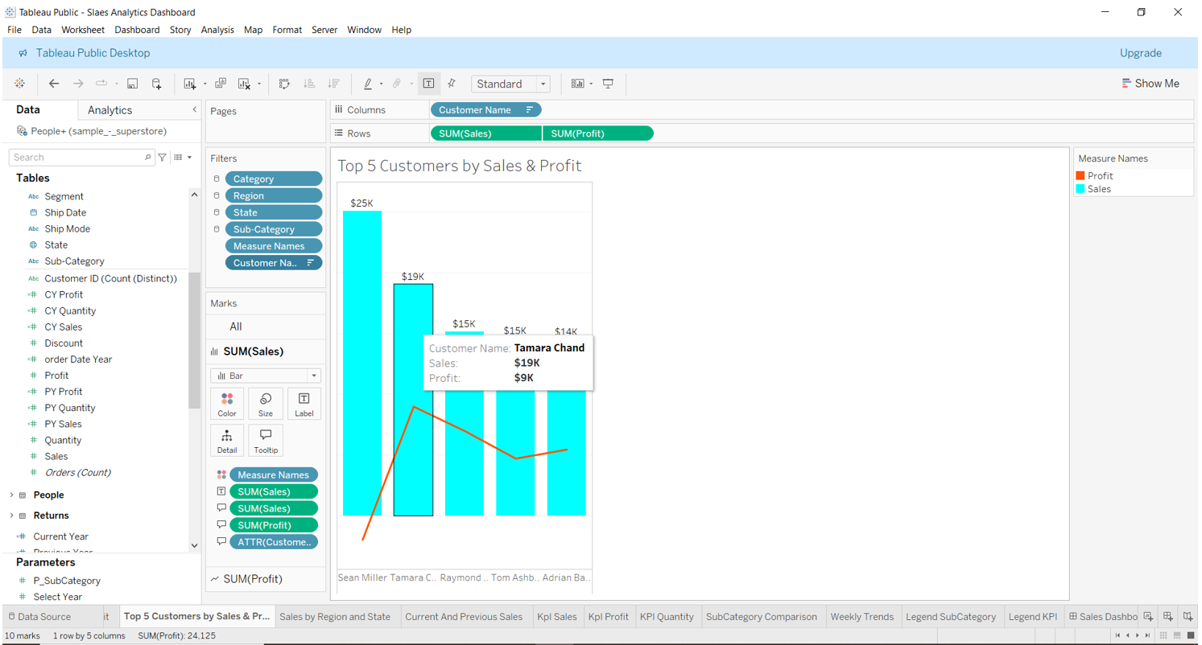
Top 5 Customers By Sales & Profit Chart

Slide 10
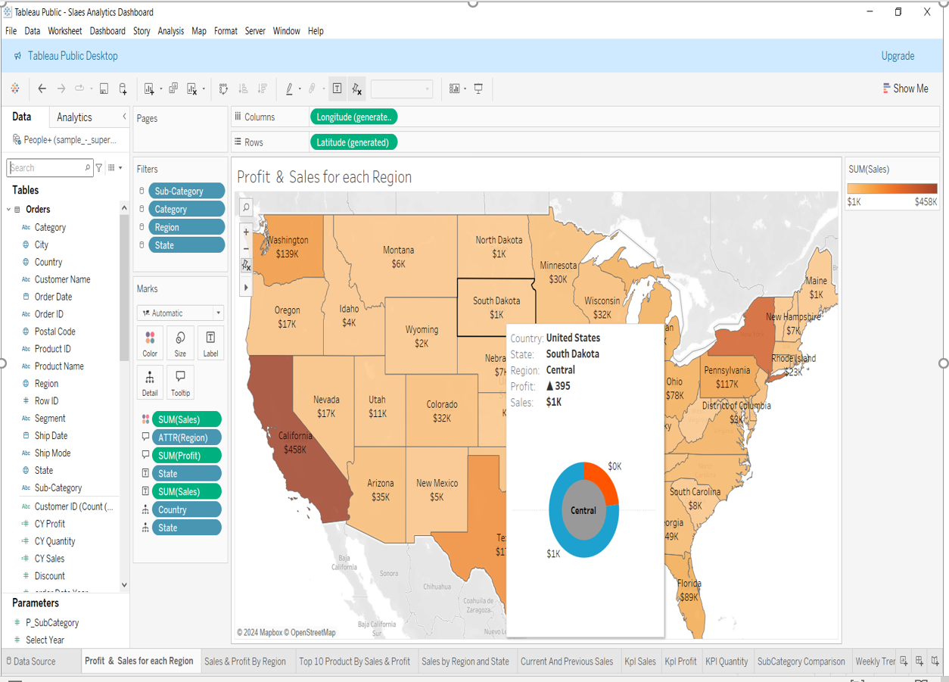
Region Sales Map Chart

Slide 11
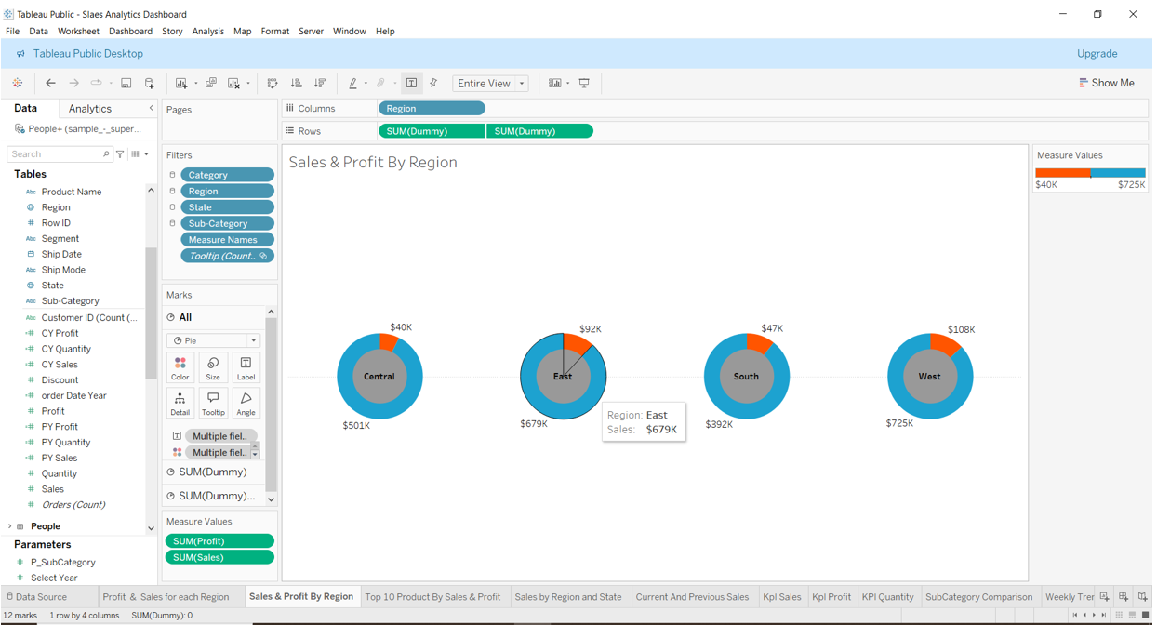
Profit & Sales By Region Chart

Slide 12
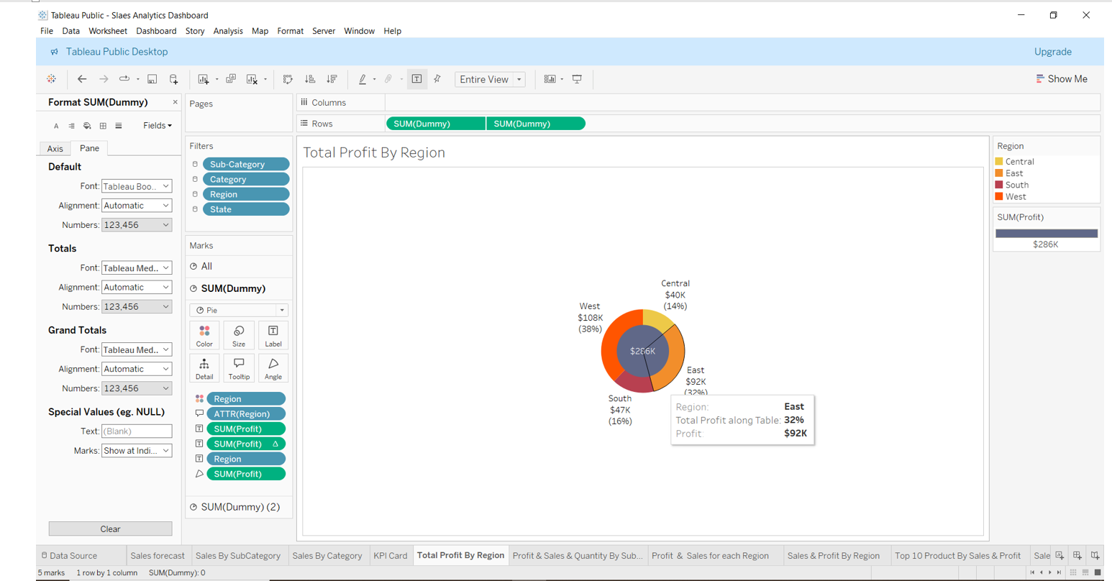
Total Profit By Region Donut Chart

Slide 13
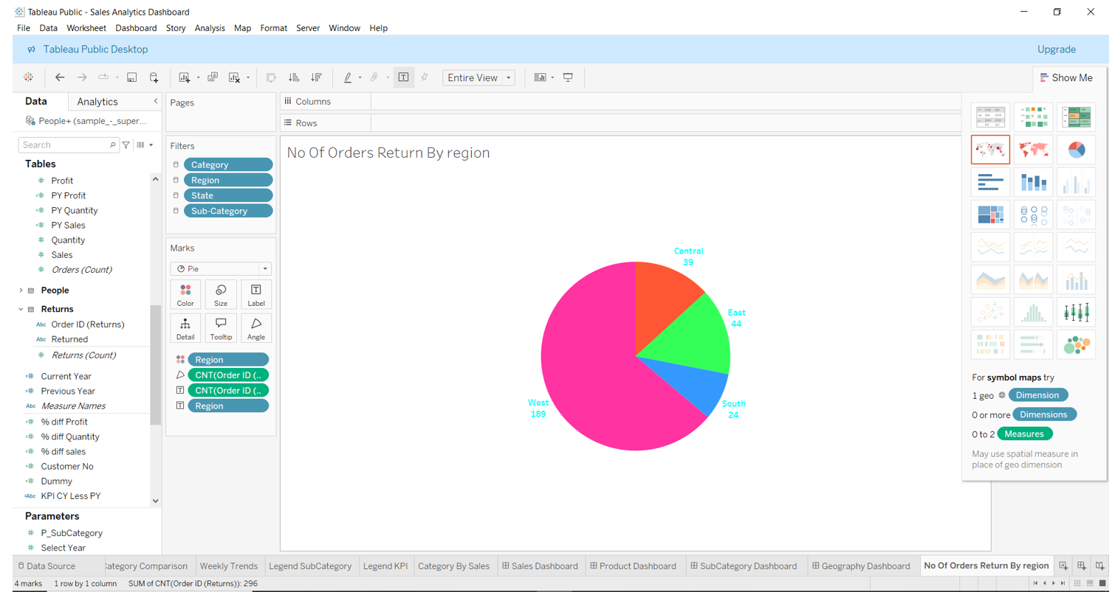
No of Order Returned Region pie Chart

Slide 14
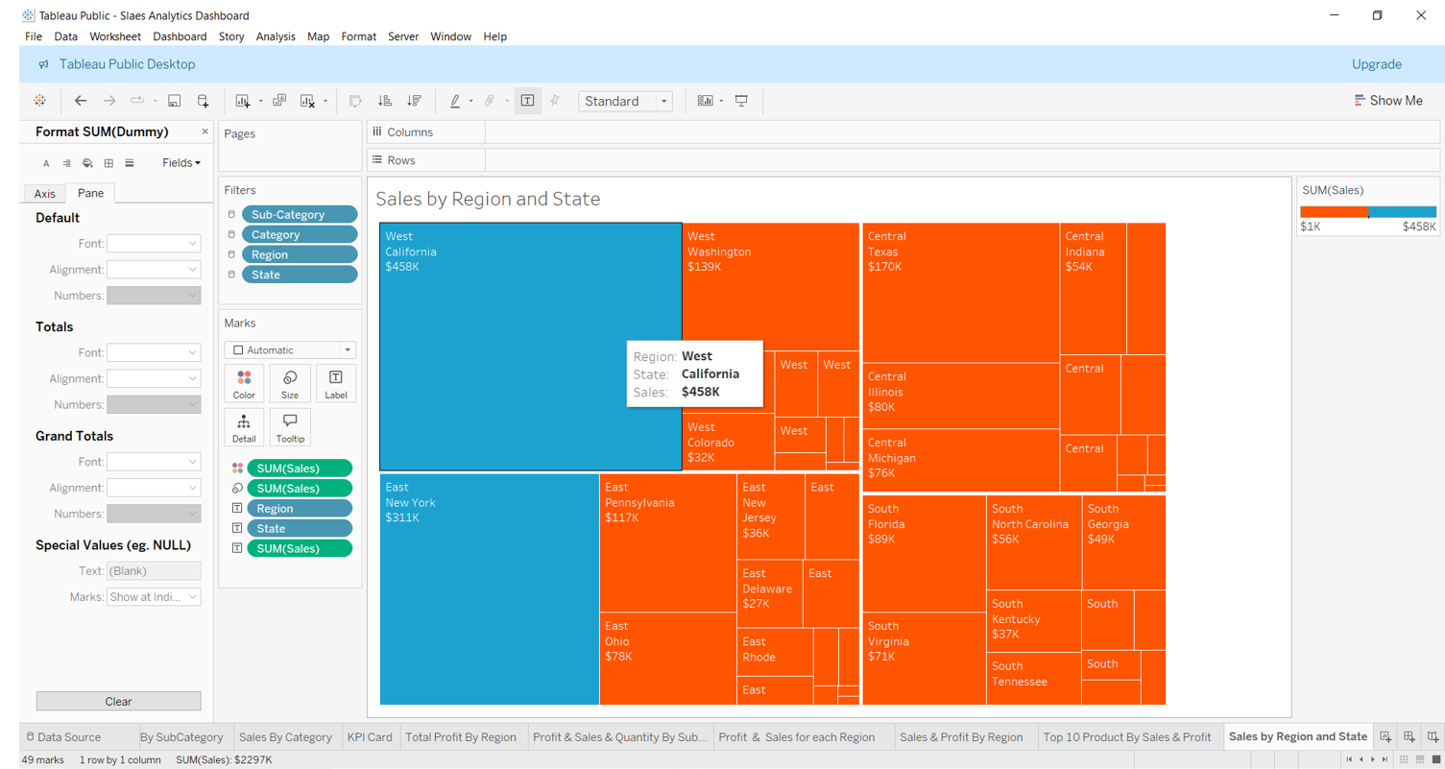
Total Sales By Region & State TreeMap Chart

Slide 15
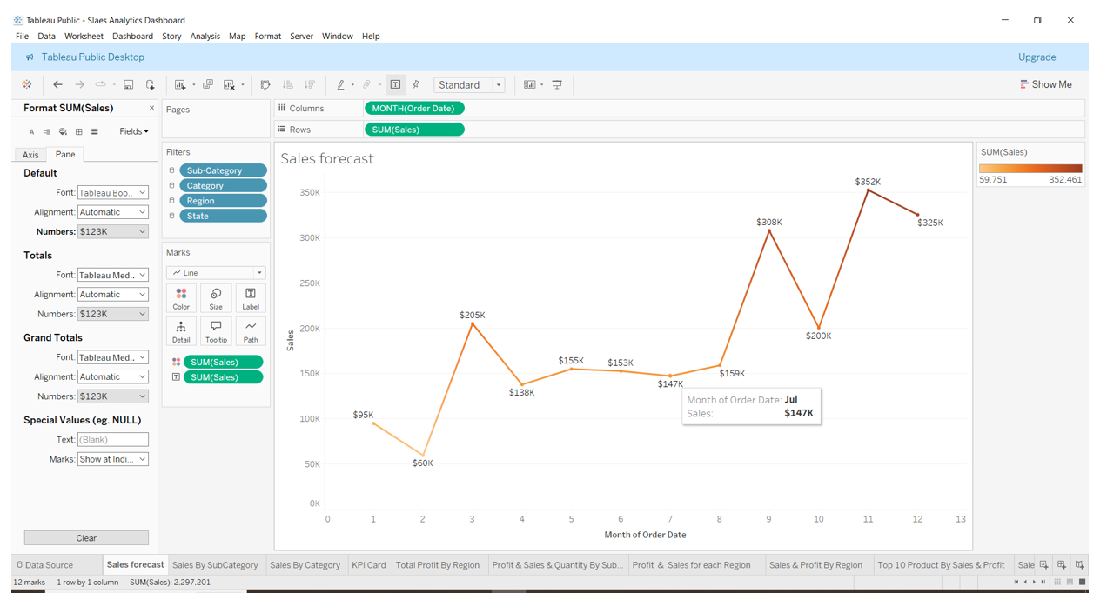
Sales Trends Over Month Chart

Slide 16
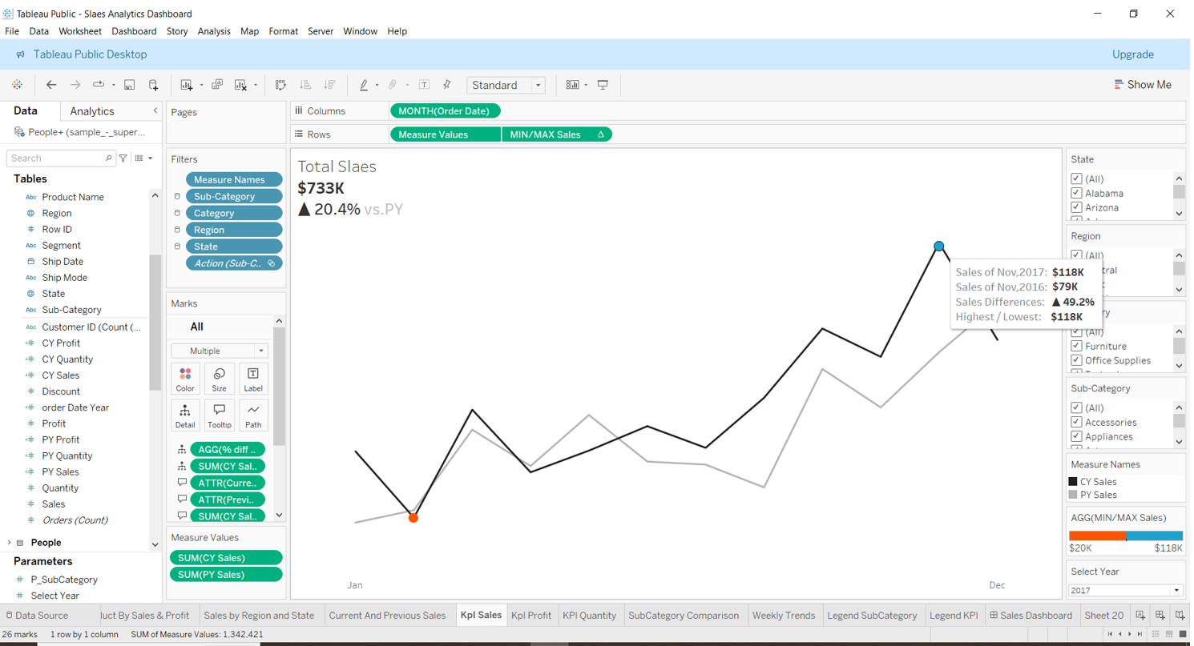
Sales KPI For Current & Previous Year Over Month

Slide 17
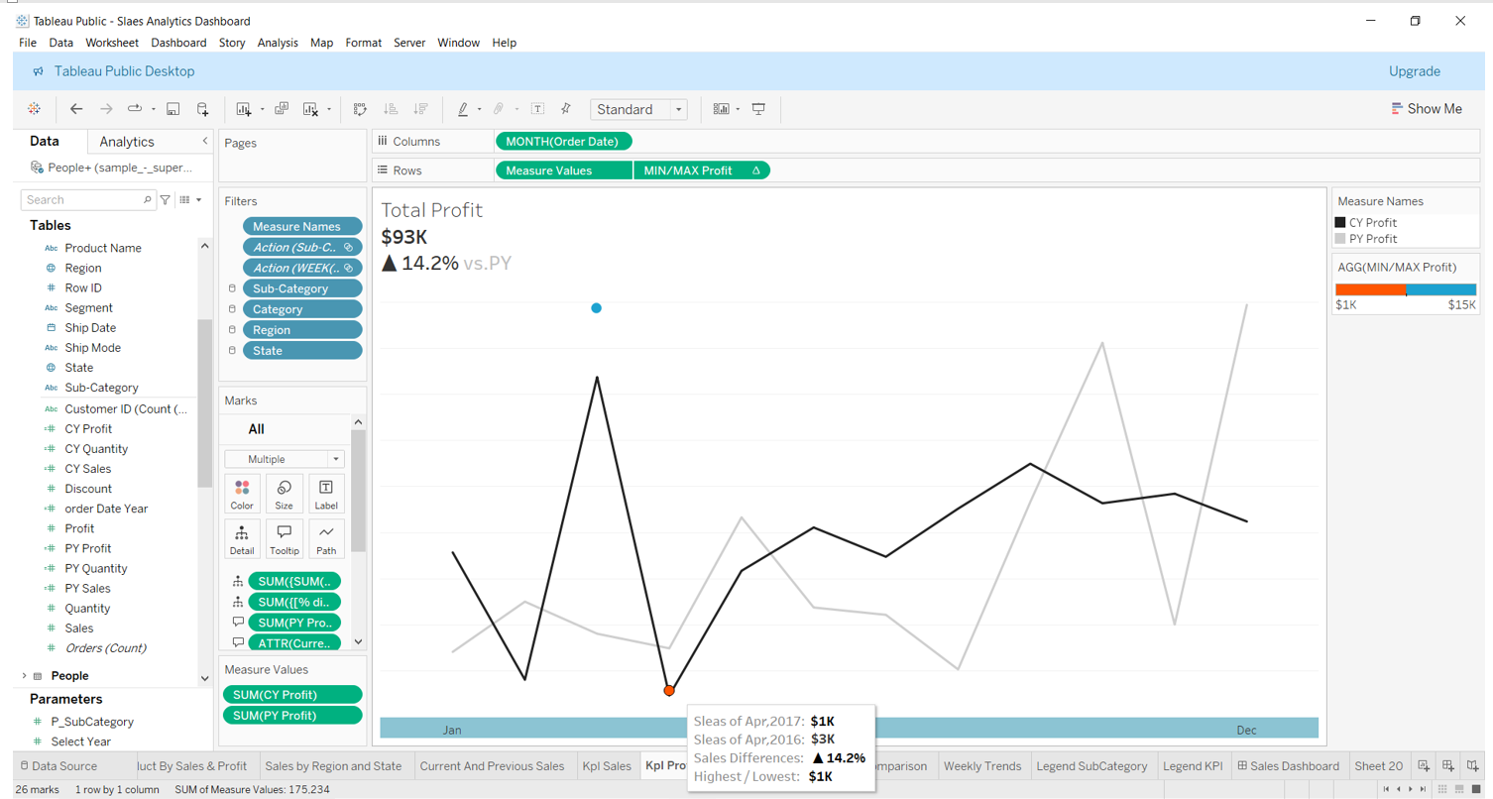
Profit KPI For Current & Previous Year Over Month

Slide 18
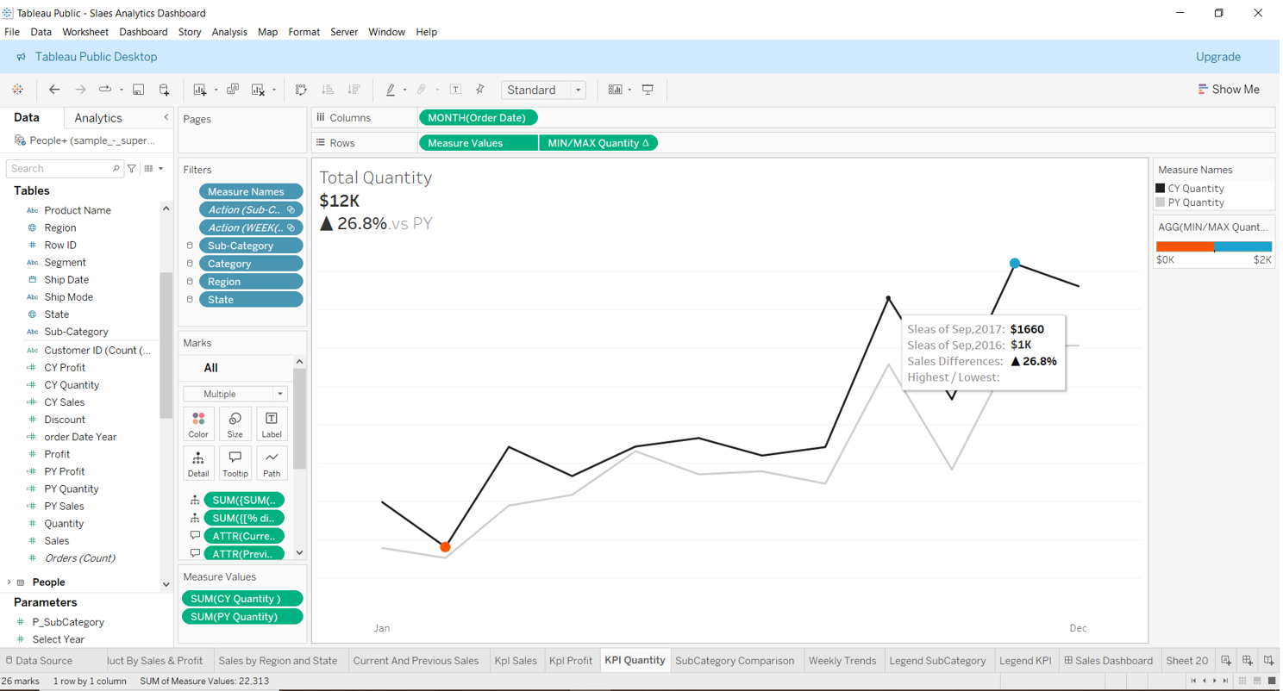
Quantity KPI For Current & Previous Year Over Month

Slide 19
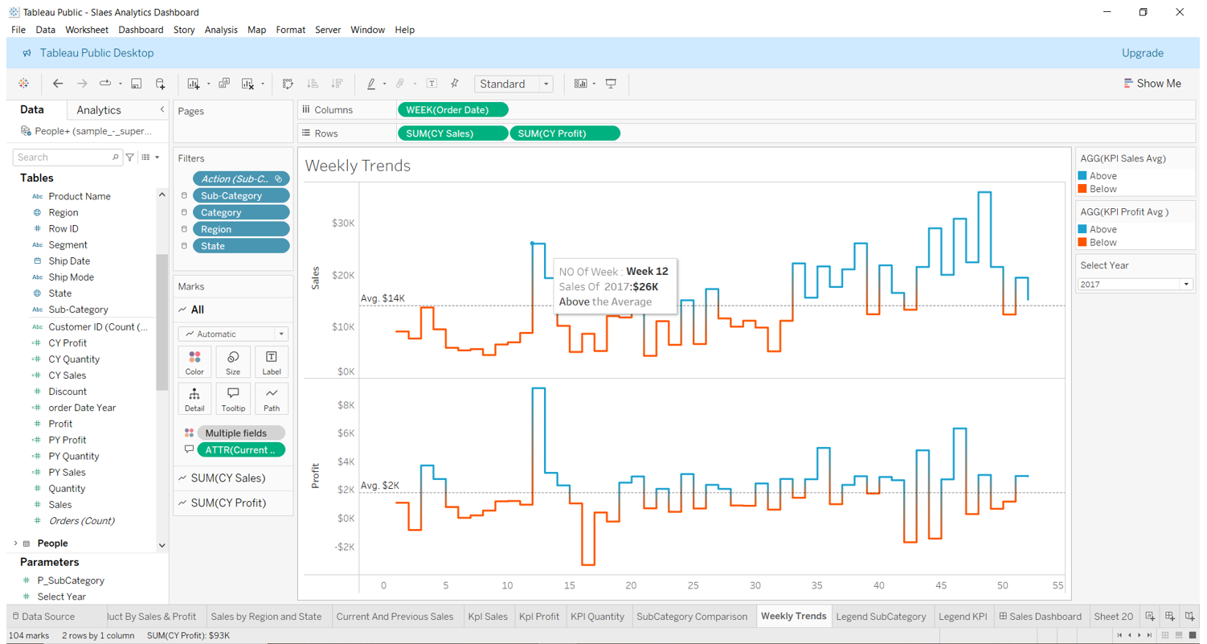
Week Trends For Current & Previous Year Over Month

Slide 20
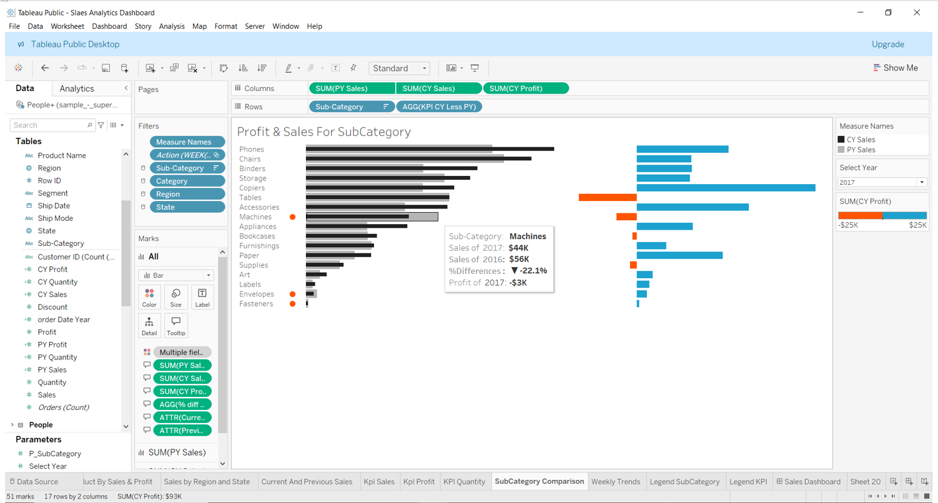
Sales & Profit SubCategory Comparison For Current & Previous Year

Slide 21
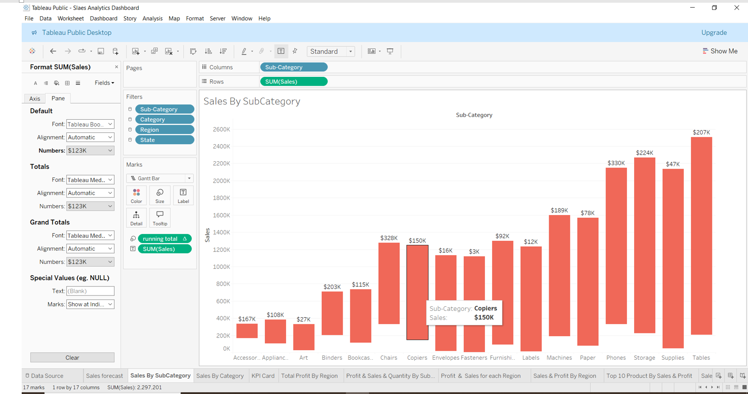
Sales By Subcategory Waterfall Chart

Slide 22
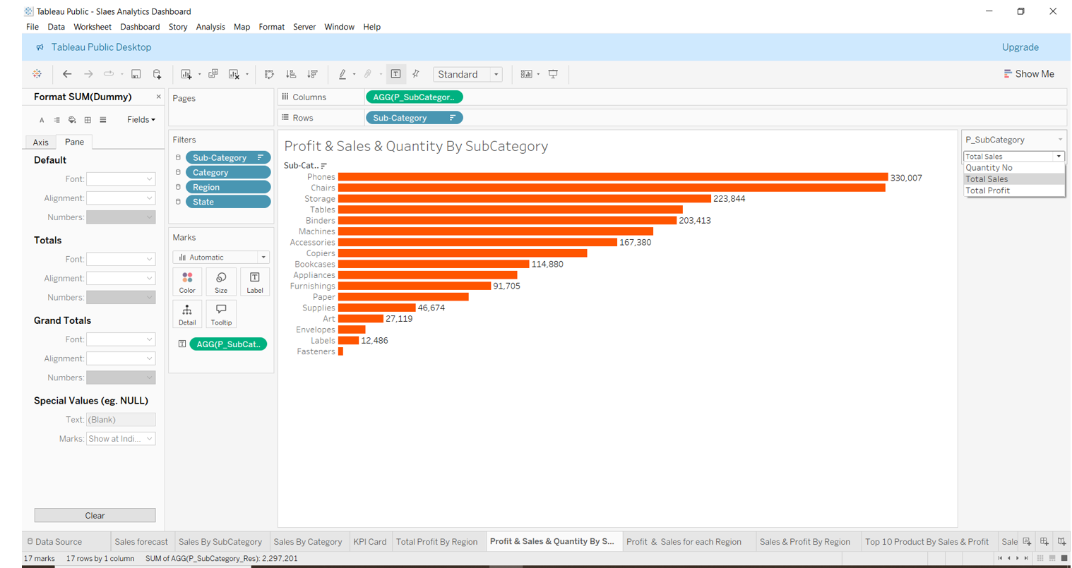
Sales & Profit & Quantity By Subcategory Using Parameter

Slide 23
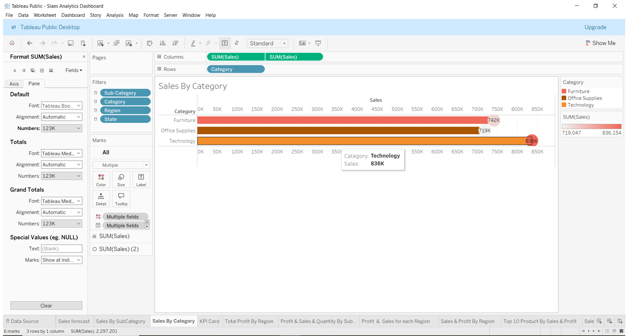
Sales By category LolliPoP Chart

Slide 24
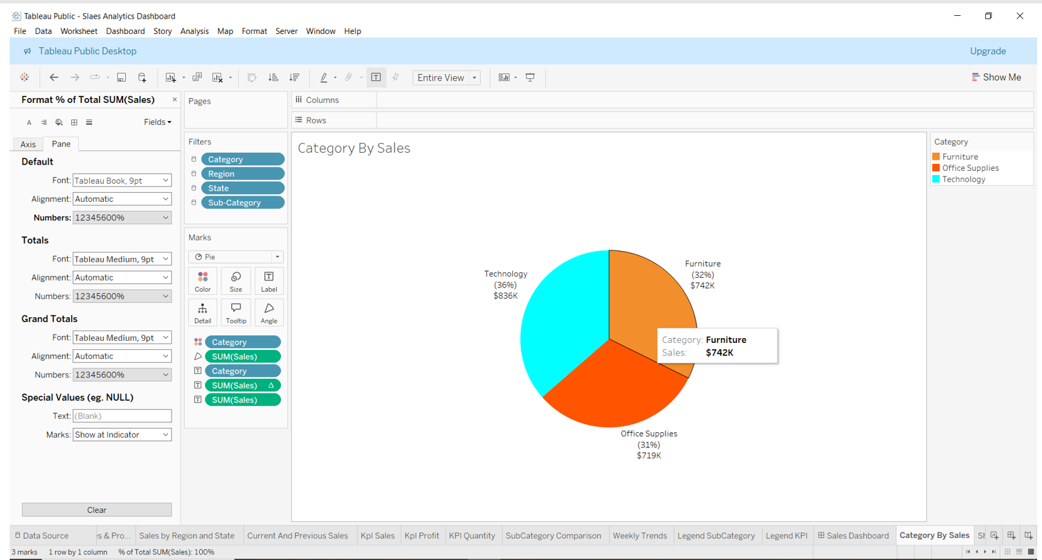
Sales By category Pie Chart

Slide 25
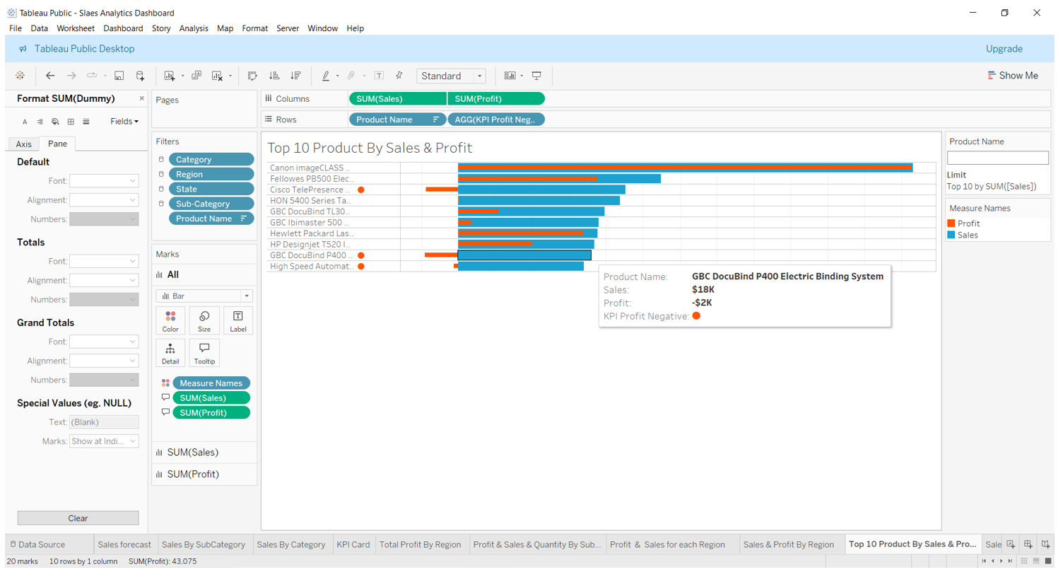
Top 10 Product BY Sales & Profit Bar in Bar Chart

Slide 26
Data Overview
Contains information about products, sales, and profits that you can use to identify key areas of improvement within this fictitious company.
Dataset : https://public.tableau.com/app/sample-data/sample_-_superstore.xls

Slide 27
Performance Highlight
1 - Sales Over Month:
The sales trend shows a significant spike in March and September, indicating potential seasonal trends or successful marketing campaigns during these periods.
2 - Sales By SubCategory:
Top Performing SubCategories: Phones and Chairs dominate with sales
of $330K and $328K respectively.
Underperforming SubCategories: Art and Fasteners are lagging behind with sales of $27K and $3K, highlighting areas that may require attention.

Slide 28
Performance Highlight
3 - Sales & Profit Trends Over Time:
The data reveals a consistent upward trend in sales, with notable peaks towards the end of the year.
Profit also follows a similar trend, though with some fluctuations, suggesting the need for improved cost management during certain periods.
4 - Profit & Sales for SubCategory:
Top Performers: Phones and Chairs led the sales with substantial profits, while categories like Accessories and Machines had mixed performance.
Areas for Improvement: Fasteners and Labels showed losses, indicating a need for strategy reassessment.

Slide 29
Performance Highlight
5 - Top Performing SubCategory:
Phones lead the sales and quantity metrics with 330,007 units sold, followed by Chairs and Storage.
SubCategories like Fasteners and Labels have the lowest sales and should be reevaluated for performance improvement.
6 - Profit Margin:
The overall profit margin stands at 12%, indicating a positive return on sales.
High sales categories like Phones and Chairs are also contributing significantly to profit, showing a strong correlation between sales volume and profitability.

Slide 30
Performance Highlight
7 - Customer Distribution:
The dashboard shows a total of 10K customers, reflecting a strong customer base.
The Top 5 Customers contribute significantly to sales, with the highest at $25K.
8 - Return Orders by Region:
The West region has the highest number of returns (189), indicating potential issues in this area that may need addressing, such as product quality or customer service.
Central and South regions show fewer returns, which may indicate better customer satisfaction or fewer issues.

Slide 31
Performance Highlight
9 - Sales by Category:
Technology is the top category in sales with $836K, followed by Furniture at $742K and Office Supplies at $719K.
This suggests a strong demand for technology products, which may guide future inventory and marketing strategies.

Slide 32
Recommendation
Focus on Top Performers: Continue to invest in the top-performing subcategories like Phones and Chairs to drive revenue growth.
Investigate Low Performers: Conduct a deeper analysis into underperforming subcategories like Art and Fasteners to understand the causes and develop strategies to boost sales.
Seasonal Promotions: Leverage the sales spike in March and September by planning targeted promotions and inventory management during these months.

Slide 33
Recommendation
Maximize High-Performing SubCategories: Focus on increasing inventory and marketing for high-profit items like Phones and Chairs to capitalize on their strong performance.
Address Underperforming Areas: Consider reevaluating pricing, promotions, or product offerings for categories like Fasteners and Labels to turn around their losses.
Seasonal Strategies: Take advantage of the peaks in sales and profit trends by aligning marketing and sales strategies with these periods.

Slide 34
Recommendation
Focus on High-Performing SubCategories:
Increase inventory and marketing efforts for top-selling SubCategories like Phones, Chairs, and Storage to capitalize on their success.
Consider cross-selling strategies with these items to further boost sales.
Investigate Low-Performing SubCategories:
SubCategories like Fasteners and Labels are underperforming and may require pricing adjustments, better marketing, or even discontinuation if they continue to show poor performance.

Slide 35
Recommendation
Address High Return Rates in the West Region:
Conduct a root cause analysis to understand why the West region has a high number of returns. Consider customer feedback, product quality, and shipping processes to reduce return rates and improve customer satisfaction.
Leverage Top Customers:
Develop loyalty programs or exclusive offers for the Top 5 Customers to retain them and encourage further purchases.
Explore personalized marketing strategies to maintain and grow these valuable customer relationships.

Slide 36
Refrences
Youtube :https://www.youtube.com/watch?v=dahrmqT5GD4&t=7173s
Book : Storytelling with Data: A Data Visualization Guide for Business Professionals Paperback – 2 November 2015
Book : Project management metrics- KPIs- and dashboards _ a guide to measuring and monitoring project performance

Slide 37


